Slide 1
Multimodal Healthcare Data Analysis for Enhanced Diagnostics and Patient Care

Slide 2
Introduction

Slide 3
MedFuse Tasks
in-hospital-mortality
predict the mortality of a patient with the time-series data and chest x-rays from the first 48hs of the icu stay.
labels belong to MIMIC-IV
phenotyping
predict 25 phenotyping labels with the time-series data and chest x-rays from the patient.
labels belong to MIMIC-IV
radiology
predict 14 radiology labels with the chest x-rays from the patient. (we can also use the time series data)
labels belong to MIMIC-CXR

Slide 4
Research Problem and Motivation
Address a significant challenge in healthcare data analysis, focusing on multimodal datasets
The challenge stems from the need to extract meaningful insights from diverse data sources, including chest X-ray images and time-series data
Three tasks carry vital implications for patient care and medical decision-making
Motivation: Improving the accuracy and effectiveness of healthcare data analysis, ultimately leading to better patient outcomes

Slide 5
Importance of Multimodal Data in Healthcare
Multimodal data, which combines different data types and sources, holds immense value in healthcare
The integration of chest X-ray images and time-series data, for instance, offers a holistic view of a patient's health status.
This holistic perspective enables more accurate diagnoses, personalized treatment plans, and proactive healthcare interventions
Harnessing the power of multimodal data has the potential to advance medical research and elevate the quality of healthcare delivery

Slide 6
Overview of Research Approach
In this study, we tried three different ideas
These methods encompass the Diffusion Model, Attention Mechanisms, and Contrastive Learning techniques
We apply these methods to address three critical healthcare tasks: Mortality Prediction, Radiology Labels, and Phenotype Classification
Our central objective is to assess the performance of these methods and compare their outcomes against those of a recent benchmark method, Medfuse

Slide 7
Related Works

Slide 8
Previous Research in Healthcare Data Analysis
In healthcare data analysis, extensive research exists across various data modalities
However, there is a notable gap in the literature concerning the integration of image and time-series data
Few studies explore the potential synergy between chest X-ray images and time-series data, highlighting the need for our research to fill this knowledge gap

Slide 9
State-of-the-Art Methods
Integrated multimodal artiﬁcial intelligence framework for healthcare applications, Soenksen et al, 2022
MedFuse: Multi-modal fusion with clinical time-series data and chest X-ray images, Hayat et al, 2022

Slide 10
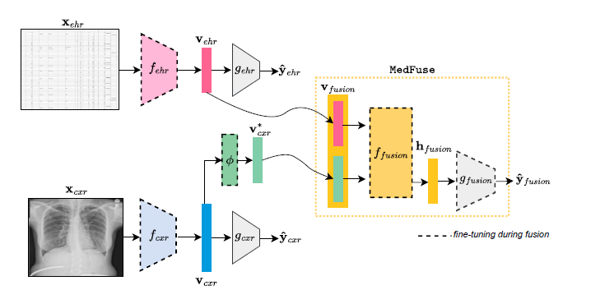
MedFuse Method
Use a ResNet-34 encoder for image modality and pre-train it
Use an LSTM encoder for time-series modality and pre-train it
Use and LSTM combined with a Fully-Connected layer for fusion and fine-tune it

Slide 11
MedFuse Method Pros/Cons
When the time-series modality is the main modality like in the phenotyping and mortality labels, the method performs well
In case of having missing images the model performs as well as a uni-model that’s trained on time-series data.
In problems where the image is the main modality, e.g., in radiology labels, the model performs poorly.

Slide 12
Method

Slide 13
MedFuse with Attention
We propose 3 Attention based models to improve MedFuse
Using ViT instead of ResNet for cxr
Using attention for the time series encoder
Using a transformer encoder and multi-head attention for fusion

Slide 14
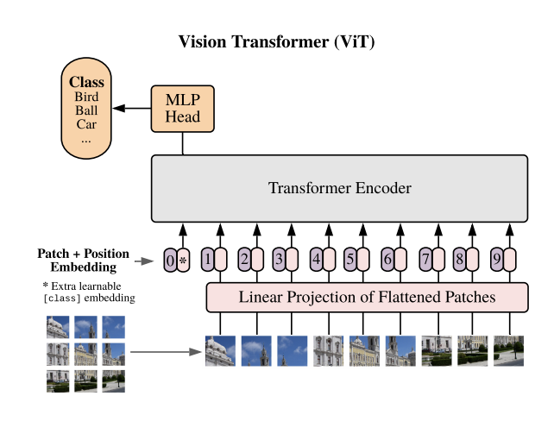
Vision Transformer Architecture

Slide 15
Introduction
we aim to change diffusion models used for classification task which used uni-modal datasets (almost images) so we can apply this tasks for multi-modal datasets (MIMIC IV) and use image and time series modalities.
base diffusion models:
1- CARD
2- DiffMIC

Slide 16
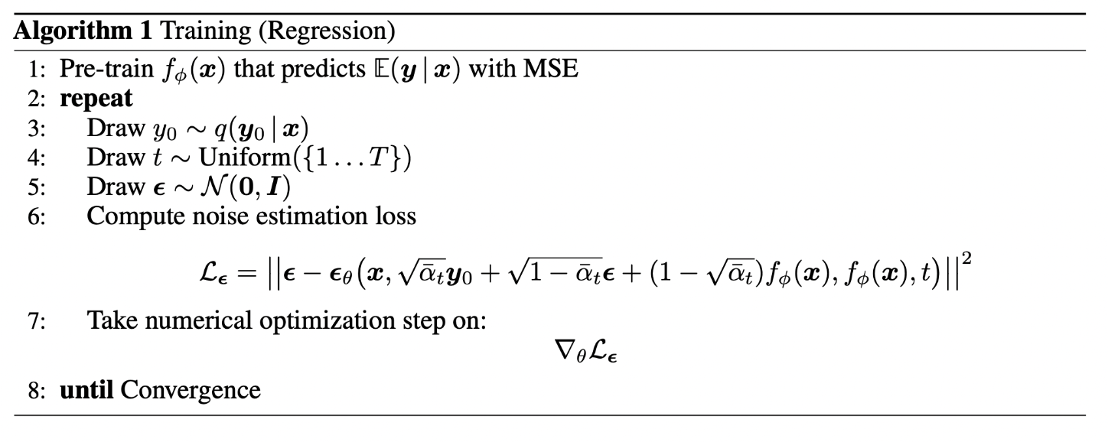
CARD Algorithm

Slide 17
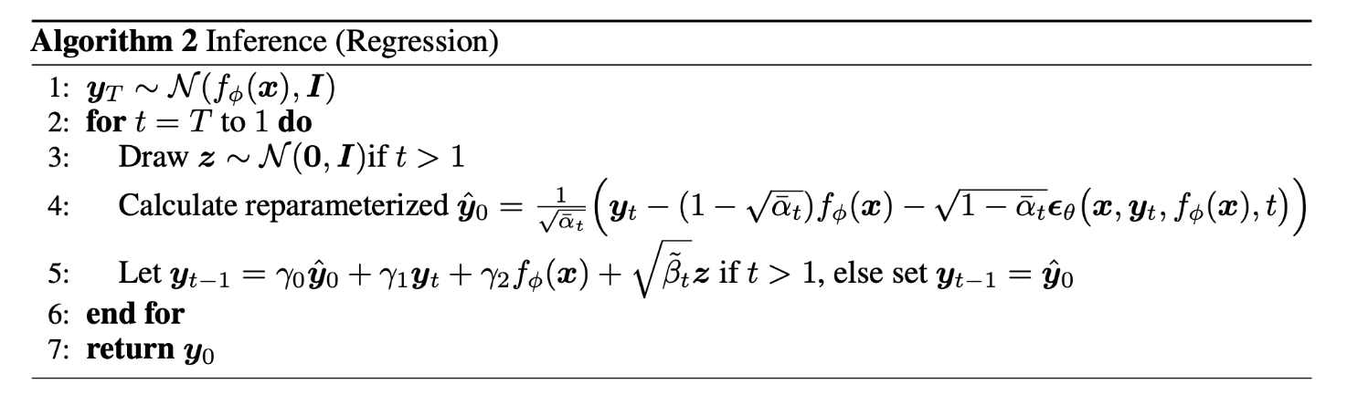
CARD Algorithm (Cont.)

Slide 18
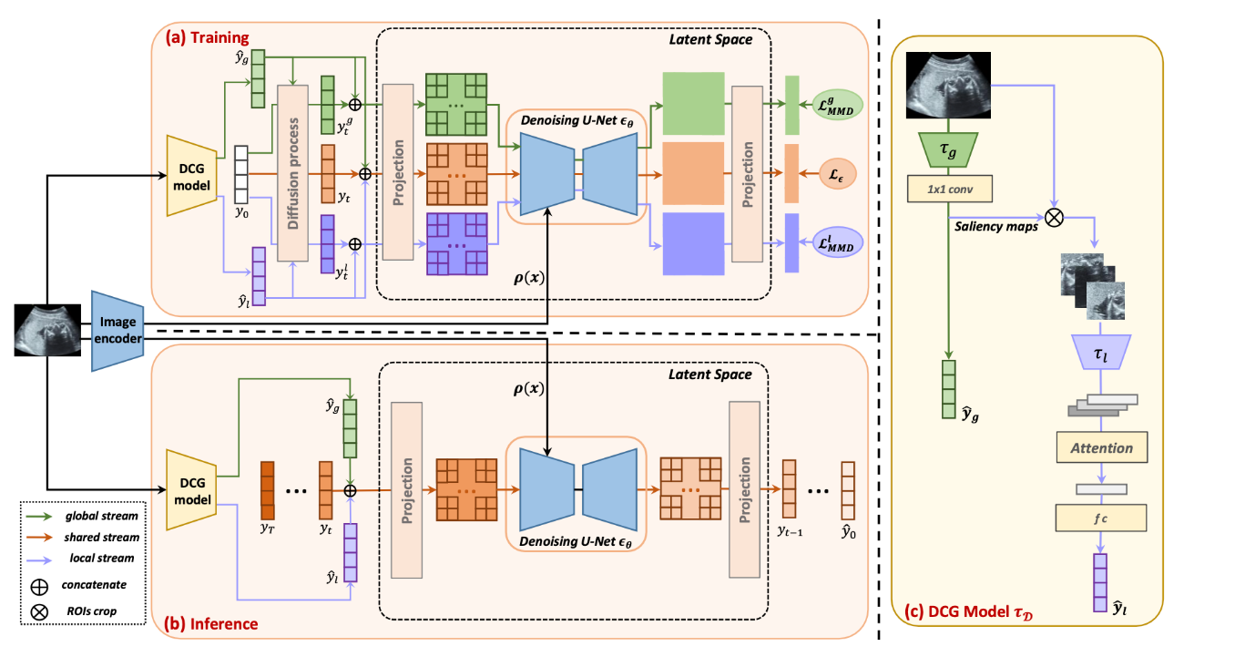
DiffMIC Algorithm

Slide 19
Models used in experiments
DiffMIC:
1- uni-modal model with image data
2- multi-modal model with image + time series data
MedFuse:
1- uni-modal model with image data
2- uni-modal model with time series data
3- multi-modal model with image + time series data

Slide 20
Multi-modal Contrastive Pre-training

Slide 21
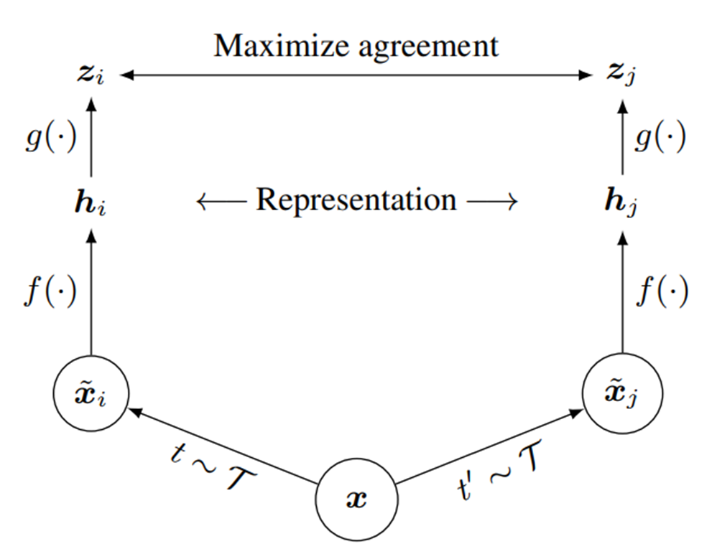
Contrastive method

Slide 22
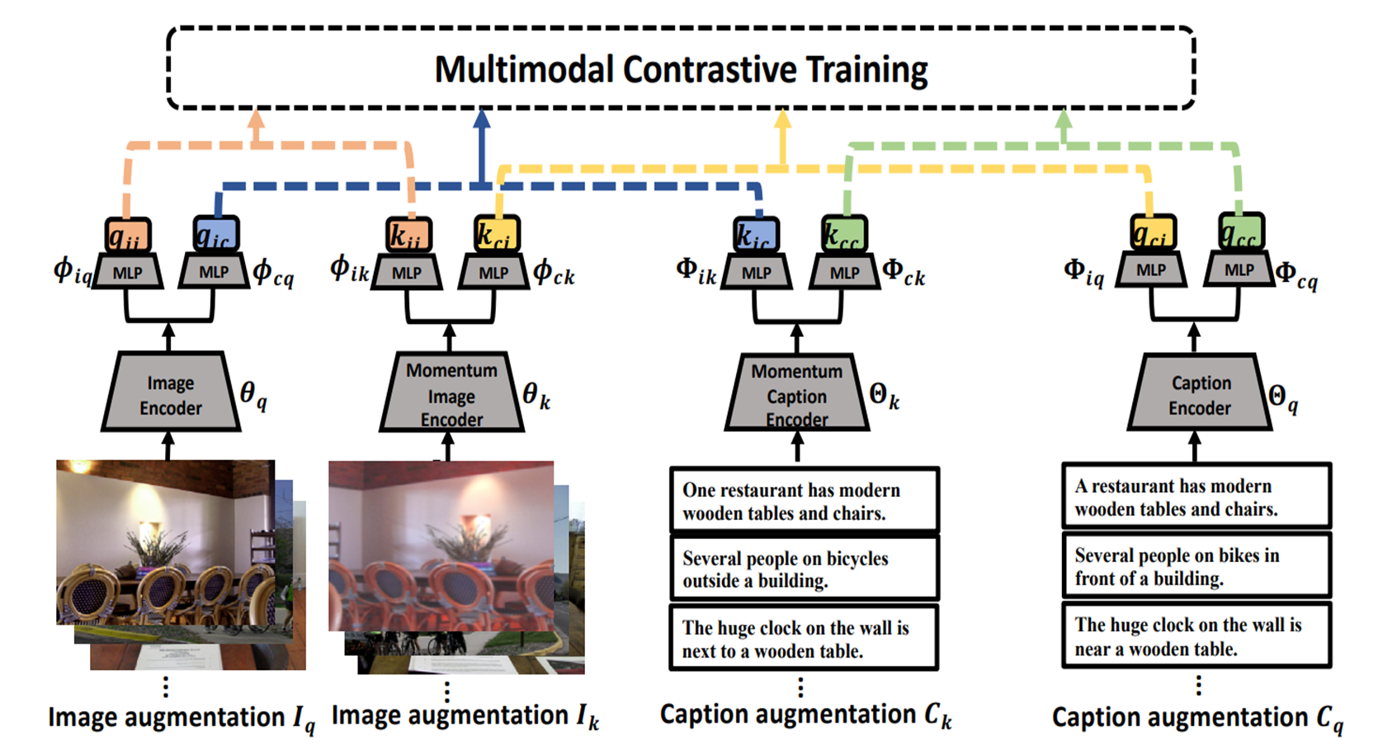
Contrastive method (Cont.)

Slide 23
Dataset

Slide 24
MedFuse Dataset
Dataset | Modality | Samples | Discription | Variables For each sample | Labels
MIMIC CXR | Image | 377K chest xray images of 65K patients | Multiple studies can be available for each patient and each study can have 1 or more images | One or multiple images | 14 binary radiology labels
MIMIC IV Preprocessed for Mortality Prediction | Time series | 26.2K episodes - train 18.8K val 2.2K test 5.2K | In each episode 17 variables where recorded over a period of 48 hours | 12 continues variables and 5 discrete variable - 76 total variables with one-hot encoding | A single binary label for Mortality
MIMIC IV Preprocessed for Phenotyping Prediction | Time series | 59.3K episodes - train 42.6K val 4.8K test 11.9K | In each episode 17 variables where recorded over the period of stay | 12 continues variables and 5 discrete variable - 76 total variables with one-hot encoding | 25 binary labels for 25 pathologies
CXR-EHR Paired - Mortality | Image / Time series | 6.8K - train 4.88K val 0.54K test 1.37K | Duration of the first 48h in icu paired with the last chest xray | 76 time series variables and an Image | A single binary label for Mortality
CXR-EHR Paired - Phenotyping | Image / Time series | 10.8K - train 7.75K val 0.88K test 2.16K | Duration of stay paired with the last chest xray | 76 time series variables and an Image | 25 binary labels for 25 pathologies
CXR-EHR Partial contains all the samples from the Paired datasets and also the samples that don’t contain an X-ray image

Slide 25
Results

Slide 26
Attention in Fusion for Phenotyping
Model | Used Modalities | Dataset | Task | Additional Settings | Tuned Hyperparameters | best mean AUC | mean AUPRC | macro F1 average for pos labels
MedFuse(EHR Only) - LSTM | Time Series | MedFuse Partial original for pheno | Phenotyping | epochs = 50 |  | 0.764 | 0.422 | 0.27
MedFuse Fused LSTM | Image/Time Series | MedFuse Partial original for pheno | Phenotyping | epochs = 50 |  | 0.764 | 0.419 | 0.29
Attention Fusion | Image/Time Series | MedFuse Partial original for pheno | Phenotyping | epochs = 50, lr = 0.00007, self-attention layer - residual connection - no normalization - no pos embedings | heads = 4 , attention_layers = 1 | 0.765 | 0.425 | 0.31
Attention Fusion | Image/Time Series | MedFuse Partial original for pheno | Phenotyping | epochs = 50, lr = 0.00007, self-attention layer - residual connection - no normalization - no pos embedings | heads = 4 , attention_layers = 1, no residual | 0.764 | 0.428 | 0.3
Attention Fusion | Image/Time Series | MedFuse Partial original for pheno | Phenotyping | epochs = 50, lr = 0.00007, transformer-encoder - no pos embedings | heads = 4 , attention_layers = 1 , dim_feed_forward=64 | 0.766 | 0.426 | 0.29
MedFuse Fused LSTM | Image/Time Series | MedFuse Partial original pheno for train - Paired for test | Phenotyping | epochs = 50 |  | 0.758 | 0.466 | 0.36
Attention Fusion | Image/Time Series | MedFuse Partial original pheno for train - Paired for test | Phenotyping | epochs = 50, lr = 0.00007, self-attention layer - residual connection - no normalization - no pos embedings | heads = 4 , attention_layers = 1 | 0.758 | 0.453 | 0.38

Slide 27
Attention in Fusion for Phenotyping
Model | Used Modalities | Dataset | Task | Additional Settings | Tuned Hyperparameters | best mean AUC | mean AUPRC | macro F1 average for pos labels
MedFuse(CXR Only) - ResNet34 | Image | MedFuse Paired original for pheno | Phenotyping | epochs = 50 | lr = 0.0005 - scheduler ReduceOnPlateau(factor=0.5, patience=10,mode=min) | 0.674 | 0.359 | 0.2
MedFuse(EHR Only) - LSTM | Time Series | MedFuse Paired original for pheno | Phenotyping | epochs = 50 |  | 0.718 | 0.406 | 0.27
MedFuse Fused LSTM | Image/Time Series | MedFuse Paired original for pheno | Phenotyping | epochs = 50 |  | 0.746 | 0.446 | 0.31
Attention Fusion | Image/Time Series | MedFuse Paired original for pheno | Phenotyping | epochs = 50, lr = 0.00007, self-attention layer - residual connection - no normalization - no pos embedings | heads = 1 , attention_layers = 1 | 0.749 | 0.45 | 0.32
Attention Fusion | Image/Time Series | MedFuse Paired original for pheno | Phenotyping | epochs = 50, lr = 0.00007, self-attention layer - residual connection - no normalization - no pos embedings | heads = 4 , attention_layers = 1 | 0.747 | 0.448 | 0.34
Early Fusion | Image/Time Series | MedFuse Paired original for pheno | Phenotyping | epochs = 50 |  | 0.751 | 0.447 | 0.34

Slide 28
Contrastive for Mortality
Model | Used Modalities | Dataset | Task | Additional Settings | Tuned Hyperparameters | Accuracy | Macro F1 | AUC | AUPRC
medfuse | ehr+cxr | partial | mortality | no pretrain | epoch = 150, batch = 64 | 88.46 | 64.01 | 83.7 | 44.5
medfuse | ehr+cxr | partial | mortality | no pretrain + not tuned for partial | epoch = 100, batch = 16 | 87.81 | 63.67 | 84.6 | 46.2
medfuse | ehr+cxr | partial | mortality | no pretrain + not tuned for partial | epoch = 150, batch = 64 | 87.71 | 63.28 | 83.5 | 44
medfuse | ehr+cxr | partial | mortality | pretrain before contrastive | epoch = 150, batch = 64 | 88.4 | 67.43 | 85.4 | 45.8
medfuse | ehr+cxr | partial | mortality | used vit for backbone without contrastive | batch = 64, n_patches = 8, n_blocks = 4, n_heads = 4 | 88.67 | 68.8 | 87 | 52.6
medfuse | ehr+cxr | partial | mortality | used vit for backbone with contrastive | epoch = 150, batch = 64, n_patches = 8, n_blocks = 4, n_heads = 4 | 89.12 | 69.04 | 85.2 | 52
medfuse | ehr+cxr | partial | mortality | the article settings |  | 88.6 | 69.61 | 85.2 | 52.8

Slide 29
Conclusion on Contrastive
Contrastive by itself does not improve the model
By adding a better backbone for cxr, it helps the model
to use the idea it is important to find a good settings for cxr
It does not help ehr modality
One idea is to update only cxr on contrastive pre-training

Slide 30
Attention for Mortality
Model | Used Modalities | Dataset | Additional Settings | Tuned Hyperparameters | Accuracy | Macro F1 | AUC | AUPRC
medfuse | ehr+cxr | partial | used vit for backbone without contrastive | batch = 64, n_patches = 8, n_blocks = 4, n_heads = 4 | 88.67 | 68.8 | 87 | 52.6
medfuse | ehr+cxr | partial | used vit for backbone with contrastive | epoch = 150, batch = 64, n_patches = 8, n_blocks = 4, n_heads = 4 | 89.12 | 69.04 | 85.2 | 52
medfuse | ehr+cxr | partial | the article settings |  | 88.6 | 69.61 | 85.2 | 52.8
medfuse | ehr+cxr | partial | used attention only on ehr | 50 epochs,hidden_dim = 128, num_heads=1 | 89.1 | 69.3 | 86 | 47.6
medfuse | ehr+cxr | partial | attention on ehr + contrastive |  | 88.9 | 66.7 | 83.5 | 45.4
medfuse | ehr+cxr | partial | used more complex vit for cxr and normal lstm for ehr | 50 epochs, n_patches = 28, n_blocks = 4, n_heads = 4 | 89.14 | 68.75 | 86 | 50.3
medfuse | ehr+cxr | partial | attention on ehr + vit |  | 89.03 | 68.9 | 85.1 | 47.1
medfuse | ehr+cxr | partial | attention on ehr + vit + contrastive |  | 88.5 | 68.54 | 85.6 | 49
medfuse | ehr+cxr | partial | attention on ehr + vit + attention on fusion |  | 88.19 | 67.54 | 85.2 | 48.7
medfuse | ehr+cxr | partial | attention on ehr + vit + attention on fusion + contrastive |  | 88.75 | 67.21 | 84.2 | 47

Slide 31
MedFuse with Attention (Conclusion)
Using attention in fusion improves AUC and AUPRC slightly but improves binary F1 average up to 3 percent.
Using ViT instead of ResNet also improved mortality prediction AUC slightly but we have to do more experiments on phenotyping and radiology.
We also have to combine these methods and see if the results improve.
Also we got to do more experiments on using attention for ehr modality
We are doing more experiments on ViT to find optimal settings

Slide 32
Experiments on DiffMIC/CARD
experiments are done with MIMIC IV dataset (paired EHR and CXR) and the tasks in experiments are:
1- in-hospital mortality prediction
2- classification with phenotyping labels (25 labels, one model is trained for each label)
3- classification with radiology labels (14 labels, one model is trained for each label)

Slide 33
DiffMIC results:
in-hospital mortality task:
Medfuse: f1 score (macro average): 0.۷۰
DiffMIC: best result: f1 score (macro average): 0.56 (image + time series)
DiffMIC: best result: f1 score (macro average): 0.59 (image)

Slide 34
DiffMIC table results
Model | Used Modalities | Dataset | Task | Additional Settings | Tuned Hyperparameters | Accuracy | Macro F1
MedFuse | EHR + CXR | MedFuse Partial | in-hospital-mortality |  |  | 0.886 | 0.696
MedFuse | EHR | MedFuse Uni_EHR | in-hospital-mortality |  |  | 0.894 | 0.689
DiffMIC | EHR + CXR | MedFuse Paired | in-hospital-mortality | Conditioned on Time Series Embedding / DCG input is CXR Image |  | 0.782 | 0.549
DiffMIC | EHR + CXR | MedFuse Paired | in-hospital-mortality | Orginal model/ DCG input is CXR Image | epochs = 500, dcg_pretrain_epochs = 30, min_lr = 0.0001, warmup_epochs = 40 | 0.806 | 0.592
DiffMIC | EHR + CXR | MedFuse Paired | in-hospital-mortality | Orginal model/ DCG input is CXR Image | epochs = 500, dcg_pretrain_epochs = 30, min_lr = 0, warmup_epochs = 80 | 0.847 | 0.551

Slide 35
CARD results
in-hospital mortality task:
Medfuse best result: f1-score (macro average): 0.68
CARD best result: f1-score (macro average): 0.63 (with time series data)
CARD best result: f1-score (macro average): 0.58 (with image + time series)
Link to the results sheet

Slide 36
CARD table results
dataset | Task | Loss | gamma Focal loss | pretrain epochs | training epoch | joint train with prior | prior f1 score after pretraining | prior f1 score after joint training | card model f1 score
EHR | in-hospital-mortality | wieghted CE loss | _ | 30 | 600 | TRUE | 0.4271 | 0.341 | 0.634
 |  | Focal loss | 2 | 30 | 600 | TRUE | 0.4025 | 0.3636 | 0.6306
 |  | Focal loss | 5 | 30 | 600 | TRUE | 0.4051 | 0.3562 | 0.6248
EHR + CXR (image) |  | wieghted CE loss | _ | 30 | 600 | TRUE | 0.2851 | 0.2834 | 0.5772
 |  | Focal loss | 2 | 30 | 600 | TRUE | 0.3168 | 0.3013 | 0.5793
 |  | Focal loss | 5 | 30 | 600 | TRUE | 0.3017 | 0.2601 | 0.5706

Slide 37
CARD Results (Cont.)
we check the results for each label separately (because CARD cannot used for multi-label classification).
phenotyping results:
CARD has better results than medfuse on 10 labels (out of 25).
f1-score (macro average):
average of f1-score for medfuse: 0.59
average of f1-score for card: 0.58
f1-score (binary average):
average of f1-score for medfuse: 0.31
average of f1-score for card: 0.37
link to the results sheet

Slide 38
CARD Results (Cont.)
we check the results for each label separately (because CARD cannot used for multi-label classification).
radiology results:
CARD has better results than medfuse on 5 labels (out of 14).
f1-score (macro average):
average of f1-score for medfuse: 0.581
average of f1-score for card: 0.578
link to the results sheet

Slide 39
Splitter

Slide 40
Introduction
We want to introduce a novel method on multi-modal classification.
We use a combination of the MIMIC-CXR and MIMIC-EHR datasets that is used in the MedFuse Paper, this dataset contains image and time-series modalities.
Our main baseline is Medfuse but we also have diffusion based baselines CARD and DiffMIC.
We are also testing contrastive learning methods for pre-training our models.

Slide 41
MedFuse Dataset
Dataset | Modality | Samples | Discription | Variables For each sample | Labels
MIMIC CXR | Image | 377K chest xray images of 65K patients | Multiple studies can be available for each patient and each study can have 1 or more images | One or multiple images | 14 binary radiology labels
MIMIC IV Preprocessed for Mortality Prediction | Time series | 26.2K episodes - train 18.8K val 2.2K test 5.2K | In each episode 17 variables where recorded over a period of 48 hours | 12 continues variables and 5 discrete variable - 76 total variables with one-hot encoding | A single binary label for Mortality
MIMIC IV Preprocessed for Phenotyping Prediction | Time series | 59.3K episodes - train 42.6K val 4.8K test 11.9K | In each episode 17 variables where recorded over the period of stay | 12 continues variables and 5 discrete variable - 76 total variables with one-hot encoding | 25 binary labels for 25 pathologies
CXR-EHR Paired - Mortality | Image / Time series | 6.8K - train 4.88K val 0.54K test 1.37K | Duration of the first 48h in icu paired with the last chest xray | 76 time series variables and an Image | A single binary label for Mortality
CXR-EHR Paired - Phenotyping | Image / Time series | 10.8K - train 7.75K val 0.88K test 2.16K | Duration of stay paired with the last chest xray | 76 time series variables and an Image | 25 binary labels for 25 pathologies
CXR-EHR Partial contains all the samples from the Paired datasets and also the samples that don’t contain an X-ray image

Slide 42
MedFuse Tasks
in-hospital-mortality
predict the mortality of a patient with the time-series data and chest x-rays from the first 48hs of the icu stay.
labels belong to MIMIC-IV
phenotyping
predict 25 phenotyping labels with the time-series data and chest x-rays from the patient.
labels belong to MIMIC-IV
radiology
predict 14 radiology labels with the chest x-rays from the patient. (we can also use the time series data)
labels belong to MIMIC-CXR

Slide 43
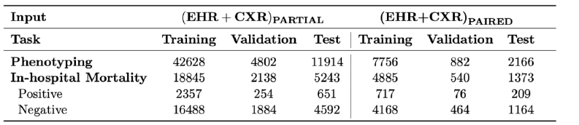
MedFuse Dataset (more info)
The Dataset is skewed.
Most of the mortality and phenotyping labels are zero.
Accuracy is not a good metric so we use F1-score, AUC and AUPRC.

Slide 44
MedFuse Method
Use a ResNet-34 encoder for image modality and pre-train it
Use an LSTM encoder for time-series modality and pre-train it
Use and LSTM combined with a Fully-Connected layer for fusion and fine-tune it

Slide 45
MedFuse Method Pros/Cons
When we have missing images the model performs as well as a uni-model that’s trained on time-series data.
When the image modality is the main modality like in the radiology labels, the method performs poorly.
When the time-series modality is the main modality like in the phenotyping and mortality labels, the method performs well.

Slide 46
MedFuse with Attention
We propose 3 Attention based models to improve MedFuse
Using a transformer encoder or multi-head attention for fusion
Using ViT instead of ResNet for cxr
Using attention for the time series encoder

Slide 47
Attention in Fusion for Phenotyping
Model | Used Modalities | Dataset | Task | Additional Settings | Tuned Hyperparameters | best mean AUC | mean AUPRC | macro F1 average for pos labels
MedFuse(EHR Only) - LSTM | Time Series | MedFuse Partial original for pheno | Phenotyping | epochs = 50 |  | 0.764 | 0.422 | 0.27
MedFuse Fused LSTM | Image/Time Series | MedFuse Partial original for pheno | Phenotyping | epochs = 50 |  | 0.764 | 0.419 | 0.29
Attention Fusion | Image/Time Series | MedFuse Partial original for pheno | Phenotyping | epochs = 50, lr = 0.00007, self-attention layer - residual connection - no normalization - no pos embedings | heads = 4 , attention_layers = 1 | 0.765 | 0.425 | 0.31
Attention Fusion | Image/Time Series | MedFuse Partial original for pheno | Phenotyping | epochs = 50, lr = 0.00007, self-attention layer - residual connection - no normalization - no pos embedings | heads = 4 , attention_layers = 1, no residual | 0.764 | 0.428 | 0.3
Attention Fusion | Image/Time Series | MedFuse Partial original for pheno | Phenotyping | epochs = 50, lr = 0.00007, transformer-encoder - no pos embedings | heads = 4 , attention_layers = 1 , dim_feed_forward=64 | 0.766 | 0.426 | 0.29
MedFuse Fused LSTM | Image/Time Series | MedFuse Partial original pheno for train - Paired for test | Phenotyping | epochs = 50 |  | 0.758 | 0.466 | 0.36
Attention Fusion | Image/Time Series | MedFuse Partial original pheno for train - Paired for test | Phenotyping | epochs = 50, lr = 0.00007, self-attention layer - residual connection - no normalization - no pos embedings | heads = 4 , attention_layers = 1 | 0.758 | 0.453 | 0.38

Slide 48
Attention in Fusion for Phenotyping
Model | Used Modalities | Dataset | Task | Additional Settings | Tuned Hyperparameters | best mean AUC | mean AUPRC | macro F1 average for pos labels
MedFuse(CXR Only) - ResNet34 | Image | MedFuse Paired original for pheno | Phenotyping | epochs = 50 | lr = 0.0005 - scheduler ReduceOnPlateau(factor=0.5, patience=10,mode=min) | 0.674 | 0.359 | 0.2
MedFuse(EHR Only) - LSTM | Time Series | MedFuse Paired original for pheno | Phenotyping | epochs = 50 |  | 0.718 | 0.406 | 0.27
MedFuse Fused LSTM | Image/Time Series | MedFuse Paired original for pheno | Phenotyping | epochs = 50 |  | 0.746 | 0.446 | 0.31
Attention Fusion | Image/Time Series | MedFuse Paired original for pheno | Phenotyping | epochs = 50, lr = 0.00007, self-attention layer - residual connection - no normalization - no pos embedings | heads = 1 , attention_layers = 1 | 0.749 | 0.45 | 0.32
Attention Fusion | Image/Time Series | MedFuse Paired original for pheno | Phenotyping | epochs = 50, lr = 0.00007, self-attention layer - residual connection - no normalization - no pos embedings | heads = 4 , attention_layers = 1 | 0.747 | 0.448 | 0.34
Early Fusion | Image/Time Series | MedFuse Paired original for pheno | Phenotyping | epochs = 50 |  | 0.751 | 0.447 | 0.34

Slide 49
Vision Transformer Architecture

Slide 50
MedFuse with Attention (Conclusion)
Using attention in fusion improves AUC and AUPRC slightly but improves binary F1 average up to 3 percent.
Using ViT instead of ResNet also improved mortality prediction AUC slightly but we have to do more experiments on phenotyping and radiology.
We also have to combine these methods and see if the results improve.

Slide 51
Multi-modal Diffusion models

Slide 52
Introduction
we aim to change diffusion models used for classification task which used uni-modal datasets (almost images) so we can apply this tasks for multi-modal datasets (MIMIC IV) and use image and time series modalities.
base diffusion models:
1- CARD
2- DiffMIC

Slide 53
CARD Algorithm

Slide 54
CARD Algorithm (Cont.)

Slide 55
DiffMIC Algorithm

Slide 56
Models used in experiments
DiffMIC:
1- uni-modal model with image data
2- multi-modal model with image + time series data
MedFuse:
1- uni-modal model with image data
2- uni-modal model with time series data
3- multi-modal model with image + time series data

Slide 57
Experiments on DiffMIC/CARD
experiments are done with MIMIC IV dataset (paired EHR and CXR) and the tasks in experiments are:
1- in-hospital mortality prediction
2- classification with phenotyping labels (25 labels, one model is trained for each label)
3- classification with radiology labels (14 labels, one model is trained for each label)

Slide 58
DiffMIC results:
in-hospital mortality task:
Medfuse: f1 score (macro average): 0.۷۰
DiffMIC: best result: f1 score (macro average): 0.56 (image + time series)
DiffMIC: best result: f1 score (macro average): 0.59 (image)

Slide 59
DiffMIC table results
Model | Used Modalities | Dataset | Task | Additional Settings | Tuned Hyperparameters | Accuracy | Macro F1
MedFuse | EHR + CXR | MedFuse Partial | in-hospital-mortality |  |  | 0.886 | 0.696
MedFuse | EHR | MedFuse Uni_EHR | in-hospital-mortality |  |  | 0.894 | 0.689
DiffMIC | EHR + CXR | MedFuse Paired | in-hospital-mortality | Conditioned on Time Series Embedding / DCG input is CXR Image |  | 0.782 | 0.549
DiffMIC | EHR + CXR | MedFuse Paired | in-hospital-mortality | Orginal model/ DCG input is CXR Image | epochs = 500, dcg_pretrain_epochs = 30, min_lr = 0.0001, warmup_epochs = 40 | 0.806 | 0.592
DiffMIC | EHR + CXR | MedFuse Paired | in-hospital-mortality | Orginal model/ DCG input is CXR Image | epochs = 500, dcg_pretrain_epochs = 30, min_lr = 0, warmup_epochs = 80 | 0.847 | 0.551

Slide 60
CARD results
in-hospital mortality task:
Medfuse best result: f1-score (macro average): 0.68
CARD best result: f1-score (macro average): 0.63 (with time series data)
CARD best result: f1-score (macro average): 0.58 (with image + time series)
Link to the results sheet

Slide 61
CARD table results
dataset | Task | Loss | gamma Focal loss | pretrain epochs | training epoch | joint train with prior | prior f1 score after pretraining | prior f1 score after joint training | card model f1 score
EHR | in-hospital-mortality | wieghted CE loss | _ | 30 | 600 | TRUE | 0.4271 | 0.341 | 0.634
 |  | Focal loss | 2 | 30 | 600 | TRUE | 0.4025 | 0.3636 | 0.6306
 |  | Focal loss | 5 | 30 | 600 | TRUE | 0.4051 | 0.3562 | 0.6248
EHR + CXR (image) |  | wieghted CE loss | _ | 30 | 600 | TRUE | 0.2851 | 0.2834 | 0.5772
 |  | Focal loss | 2 | 30 | 600 | TRUE | 0.3168 | 0.3013 | 0.5793
 |  | Focal loss | 5 | 30 | 600 | TRUE | 0.3017 | 0.2601 | 0.5706

Slide 62
CARD Results (Cont.)
we check the results for each label separately (because CARD cannot used for multi-label classification).
phenotyping results:
CARD has better results than medfuse on 10 labels (out of 25).
f1-score (macro average):
average of f1-score for medfuse: 0.59
average of f1-score for card: 0.58
f1-score (binary average):
average of f1-score for medfuse: 0.31
average of f1-score for card: 0.37
link to the results sheet

Slide 63
CARD Results (Cont.)
we check the results for each label separately (because CARD cannot used for multi-label classification).
radiology results:
CARD has better results than medfuse on 5 labels (out of 14).
f1-score (macro average):
average of f1-score for medfuse: 0.581
average of f1-score for card: 0.578
link to the results sheet

Slide 64
Another works
use attention in pre-trained classifier or in U-net network:
the results are worse than before (in contrast with medfuse which attention helps to have better results)
sample from train datasets to make them more balanced -> results does not change a lot on test dataset.
use pre-trained models as decoder in card model -> results does not change a lot on test dataset.

Slide 65
Conclusion
DiffMIC model underperforms than Medfuse for mortality prediction
CARD model also underperforms Medfuse for mortality prediction.
CARD model has the slightly same result as MedFuse for phenotyping task by f1-score (macro average) but outperforms by f1-score (binary average)
this context is also true for radiology task

Slide 66
Results for experiments
Only used new backbones for every each modality:
Attention on ehr: Accuracy: 89.1 and f1 score: 69.3
Vit on cxr: Accuracy: 88.67 and f1 score: 68.8
Applying contrastive pretraining:
Attention on ehr: Accuracy: 88.9 and f1 score: 66.7
Vit on cxr: Accuracy: 89.12 and f1 score: 69.04
A more complex settings for vit and not using contrastive:
Vit on cxr: Accuracy: 89.14 and f1 score: 68.75

Slide 67
Results for both backbones
We used both attention for ehr and vit for cxr and there are can be used different methods like contrastive pretraining and attention on fusion:
No contrastive and no fusion: Accuracy: 89.03 and f1 score: 68.9
No contrastive and fusion: Accuracy: 11.39 and f1 score: 10.37

Slide 68
What next?
more results on ViT and contrastive: Different results on different models
Image preprocessing: Using filtering methods like MUSICA
Do more experiments with better settings of fusion attention
New contrastive algorithm

Slide 69
Thank you

